Slide 1

PROPERTY MANAGEMENT APPLICATION
By using the Salesforce developer

Slide 2
Overview:
This project focuses on the design and development of a
Web enable database management system for the organization and property management system. This property management system is a software where property details such as house details, schedules,address
and are been setup by an administrator.

Slide 3
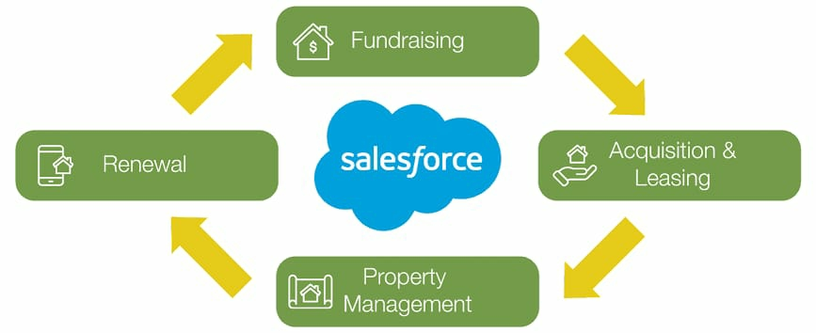

Slide 4
PURPOSE:
The main purpose of the Property management enables the reality managers to keep track of crucial data about the financial and household properties incoporating associated cash flow primary tenants and occupancy rates. The property owners achieve this by hiring a reputable property management company.

Slide 5
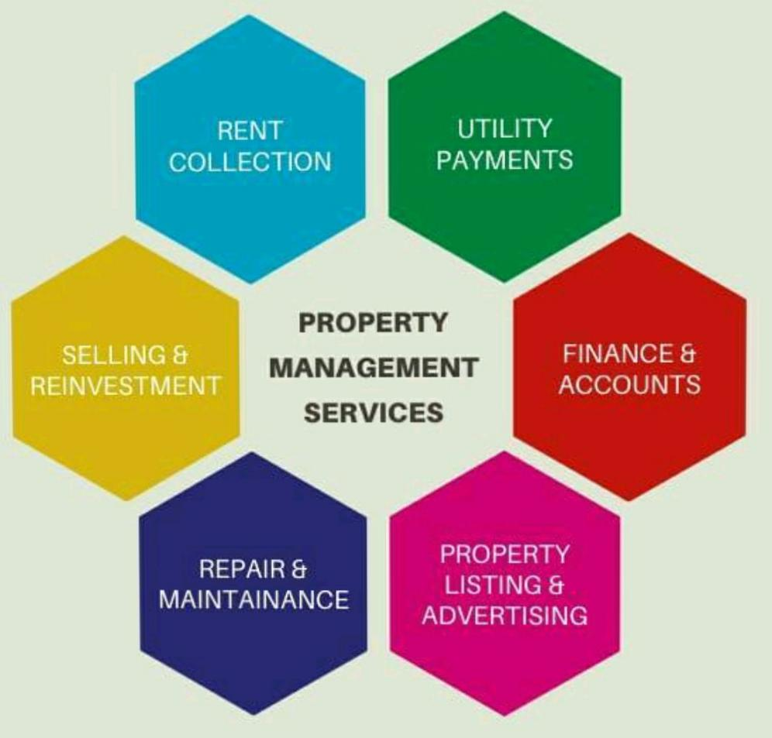

Slide 6


Slide 7
ADVANTAGES AND DISADVANTAGES
ADVANTAGES
DISADVANTAGES
Easy maintenance monitoring.
Data tracking.
Quick inspection.
Better reporting.
Easy payments from tenants and contractors.
You will be dependent on one vendor.
Time consuming if you choose a wrong system.
It seems expensive for small businesses.

Slide 8
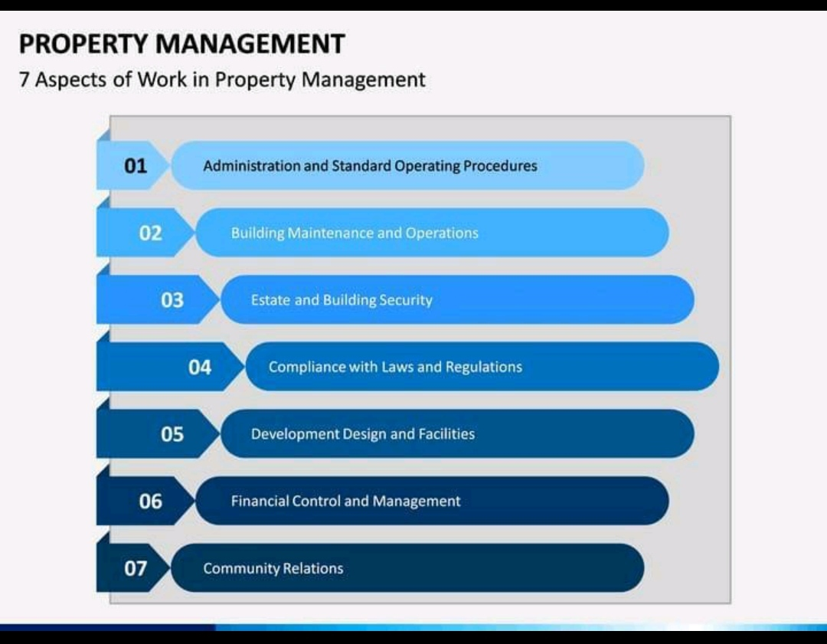

Slide 9
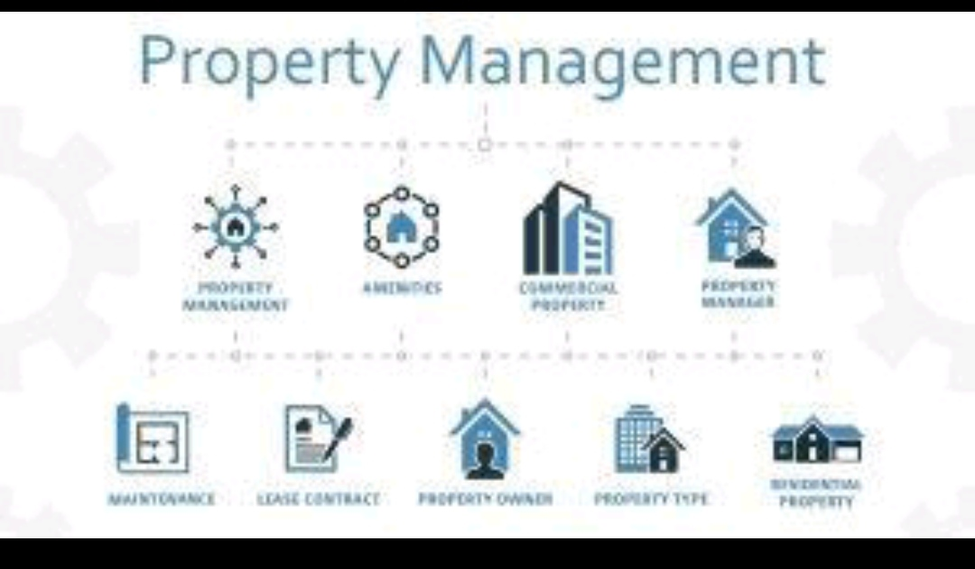

Slide 10

FUTURE SCOPE
Salesforce paves the way for streamlined business automation to perform all the looped tasks. It enables skilled employees to perform the more important work. 2023 will see more technological advancement in automating work. Zero code tools will handle over 50% of app development within two years.

Slide 11
Conclusion
In conclusion, Salesforce CRM is a powerful tool that provides small businesses with a centralized platform to manage their sales, marketing, and customer service processes. It helps small businesses to improve their customer engagement, streamline their sales processes, and increase their marketing ROI.

Slide 12


